Slide 1

Tree

Slide 2

Linear and Non Linear Data Structure
Arrays, Linked lists, Stacks, Queues are linear structure.
  Why linear
    The elements are totally ordered.
    For any pair of elements, one precedes the other.
We can have non-linear structure
  Tree, Graph are non linear data strucutre
    Elements are not totally ordered.

Slide 3
Tree Data structure
A tree is a finite set of one or more nodes
such that:
There is a specially designated node called the root.
The remaining nodes are partitioned into n>=0 disjoint sets T1, ..., Tn, where each of these sets is a tree.
We call T1, ..., Tn the subtrees of the root.

Slide 4
Tree representation
A
C
D
E
F
H
I
J
K
L
M
P
Q

Slide 5
Tree representation
A
Root
C
D
E
F
H
I
J
K
L
M
Subtree with single node
P
Q
Subtree with root F
Subtree with root D
Subtree with root E

Slide 6
Tree Terminology
A
Level 0
Root
Parent
Child
Siblings
Leaves
E
Level 1
B
C
D
F
G
H
Level 2
Root is the node which has no parent.
Siblings are nodes which has common parent.
Leaves are node which has no child node.
Every node except Root node has parent.
I
Level 3

Slide 7
Tree Terminology
A
Level 0
Root
Parent
Child
Siblings
Leaves
E
Level 1
B
C
D
F
G
H
Level 2
A is Root Node
A is Parent of B, C, D and E
F and G are Child of D
F, and G are Siblings
B, C, F, G and I are leaves
I
Level 3

Slide 8
Tree Terminology
Depth of a node is equal to its level.
Height of Tree is equal to the total number of levels.
The Degree of node is equal to its Childs.
External Node: a node which has no child.
Internal Node: a node which has atleast one child.

Slide 9
Tree Terminology
A
Level 0
E
Level 1
B
C
D
Depth of H (level) is 2
Height of Tree is 3
The Degree of node D is 2
B, C, F, G and I are External
A , D, E, H are internal node of Tree
F
G
H
Level 2
I
Level 3

Slide 10
Binary Trees

Slide 11
Binary Tree
Binary Tree:
  Ordered tree with all nodes having at most two children

Slide 12
Some examples
A
B
C
D
E
F
G
H
I
Binary tree

Slide 13
Structures which are not binary trees
A
B
C
D
E
F
G
I

Slide 14
Various binary trees
Ordered binary Tree:
  Is a tree in which the children of each node are ordered.
Strictly Binary Tree:
If every non leaf node in a binary tree has non empty left and right sub trees then such tree is termed as a strictly binary tree.
Complete Binary Tree:
  A complete binary tree of height h is the strict binary tree all of whose leaves are at level h.

Slide 15
1
A
2
B
3
C
D
E
6
F
7
G
4
5
8
H
9
I
J
10
Ordered Binary Tree

Slide 16
Ex: of a strictly binary tree
A
B
C
D
E
F
G

Slide 17
A COMPLETE BINARY TREE OF DEPTH 3
A
B
C
D
E
G
F
H
I
J
K
L
M
N
O

Slide 18
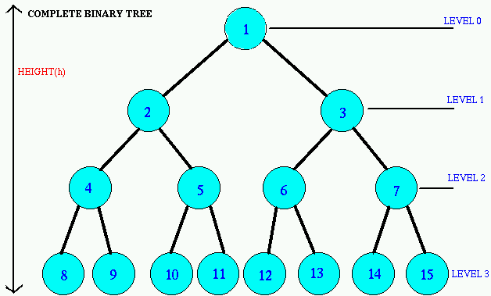
Complete Binary Tree
Level i has 2^{i} nodes
in a tree of height h
  Leaves are at level h
  No of leaves is 2^{h}
  No of internal nodes is 2^{h} -1
  Total nodes N= 2^{h} + 2^{h} -1
  N = 2. 2^{h} -1= 2^{h+1} -1
  N=2^{h+1} -1 ---→ log₂N=h+1-log₂1
  log₂N =h+1-→h= log₂N-1
  h= O(log₂N)

Slide 19
Operations on Binary Trees
Finding duplicates
Traversing a binary tree
Searching

Slide 20
Binary Tree Traversals

Slide 21

Tree Traversal
Many binary tree operations are done by performing a traversal of the binary tree.
In a traversal, each element of the binary tree is visited exactly once.

Slide 22
Three tree traversal methods
Preorder traversal
Inorder traversal
Postorder traversal
Level Order traversal

Slide 23
Preorder Traversal
Steps:
Visit the root
Traverse the left subtree in preorder
Traverse the right subtree in preorder

Slide 24

Traversing a Tree Preorder
A
B
C
D
E
F
G
H
I

Slide 25
Traversing a Tree Preorder
A
B
C
D
E
F
G
H
I
Result: A

Slide 26
Traversing a Tree Preorder
A
B
C
D
E
F
G
H
I
Result: AB

Slide 27
Traversing a Tree Preorder
A
B
C
D
E
F
G
H
I
Result: ABD

Slide 28
Traversing a Tree Preorder
A
B
C
D
E
F
G
H
I
Result: ABDE

Slide 29
Traversing a Tree Preorder
A
B
C
D
E
F
G
H
I
Result: ABDEH

Slide 30
Traversing a Tree Preorder
A
B
C
D
E
F
G
H
I
Result: ABDEHC

Slide 31
Traversing a Tree Preorder
A
B
C
D
E
F
G
H
I
Result: ABDEHCF

Slide 32
Traversing a Tree Preorder
A
B
C
D
E
F
G
H
I
Result: ABDEHCFG

Slide 33
Traversing a Tree Preorder
A
B
C
D
E
F
G
H
I
Result: ABDEHCFGI

Slide 34
Inorder Traversal (symmetric order)
Steps for a nonempty binary tree:
Traverse the left subtree in inorder
Visit the root
Traverse the right subtree in inorder

Slide 35
Traversing a Tree Inorder
A
B
C
D
E
F
G
H
I

Slide 36
Traversing a Tree Inorder
A
B
C
D
E
F
G
H
I

Slide 37
Traversing a Tree Inorder
A
B
C
D
E
F
G
H
I

Slide 38
Traversing a Tree Inorder
A
B
C
D
E
F
G
H
I
Result: D

Slide 39
Traversing a Tree Inorder
A
B
C
D
E
F
G
H
I
Result: DB

Slide 40
Traversing a Tree Inorder
A
B
C
D
E
F
G
H
I
Result: DB

Slide 41
Traversing a Tree Inorder
A
B
C
D
E
F
G
H
I
Result: DBH

Slide 42
Traversing a Tree Inorder
A
B
C
D
E
F
G
H
I
Result: DBHE

Slide 43
Traversing a Tree Inorder
A
B
C
D
E
F
G
H
I
Result: DBHEA

Slide 44
Traversing a Tree Inorder
A
B
C
D
E
F
G
H
I
Result: DBHEA

Slide 45
Traversing a Tree Inorder
A
B
C
D
E
F
G
H
I
Result: DBHEAF

Slide 46
Traversing a Tree Inorder
A
B
C
D
E
F
G
H
I
Result: DBHEAFC

Slide 47
Traversing a Tree Inorder
A
B
C
D
E
F
G
H
I
Result: DBHEAFCG

Slide 48
Traversing a Tree Inorder
A
B
C
D
E
F
G
H
I
Result: DBHEAFCGI

Slide 49
Postorder Traversal
Steps:
Traverse the left subtree in postorder
Traverse the right subtree in postorder
Visit the root

Slide 50
Traversing a Tree Postorder
A
B
C
D
E
F
G
H
I

Slide 51
Traversing a Tree Postorder
A
B
C
D
E
F
G
H
I
Result:

Slide 52
Traversing a Tree Postorder
A
B
C
D
E
F
G
H
I
Result:

Slide 53
Traversing a Tree Postorder
A
B
C
D
E
F
G
H
I
Result: D

Slide 54
Traversing a Tree Postorder
A
B
C
D
E
F
G
H
I
Result: D

Slide 55
Traversing a Tree Postorder
A
B
C
D
E
F
G
H
I
Result: DH

Slide 56
Traversing a Tree Postorder
A
B
C
D
E
F
G
H
I
Result: DHE

Slide 57
Traversing a Tree Postorder
A
B
C
D
E
F
G
H
I
Result: DHEB

Slide 58
Traversing a Tree Postorder
A
B
C
D
E
F
G
H
I
Result: DHEB

Slide 59
Traversing a Tree Postorder
A
B
C
D
E
F
G
H
I
Result: DHEBF

Slide 60
Traversing a Tree Postorder
A
B
C
D
E
F
G
H
I
Result: DHEBF

Slide 61
Traversing a Tree Postorder
A
B
C
D
E
F
G
H
I
Result: DHEBFI

Slide 62
Traversing a Tree Postorder
A
B
C
D
E
F
G
H
I
Result: DHEBFIG

Slide 63
Traversing a Tree Postorder
A
B
C
D
E
F
G
H
I
Result: DHEBFIGC

Slide 64
Traversing a Tree Postorder
A
B
C
D
E
F
G
H
I
Result: DHEBFIGCA

Slide 65
Tree Traversal – Example 1
A
B
C
D
E
F
G
H
I
Preorder:
Inorder:
Postorder:
ABDGCEHIF
DGBAHEICF
GDBHIEFCA

Slide 66
Tree Traversal – Example 2
A
Preorder: ABCEIFJDGHKL
Inorder: EICFJBGDKHLA
Postorder: IEJFCGKLHDBA
B
C
D
G
H
E
F
K
L
I
J

Slide 67

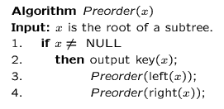
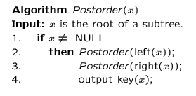
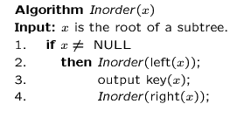
Preorder, Postorder and Inorder

Slide 68
Level Order Traversal
Start at the root
Visit the nodes at each level, from left to right
Is there a recursive algorithm for a level order traversal?

Slide 69
Level Order Traversal
A
B
C
D
E
F
G
H
I
Nodes will be visited in the order ABCDEFGHI

Slide 70

Level Order Traversal
Start at the root
Visit the nodes at each level, from left to right
A
B
C
D
E
F
G
H
I
queue

Slide 71
Level Order Traversal
Start at the root
Visit the nodes at each level, from left to right
A
B
C
D
E
F
G
H
I
A

Slide 72
Level Order Traversal
Start at the root
Visit the nodes at each level, from left to right
A
B
C
D
E
F
G
H
I
A

Slide 73
Level Order Traversal
Start at the root
Visit the nodes at each level, from left to right
A
B
C
D
E
F
G
H
I
B C
A

Slide 74
Level Order Traversal
Start at the root
Visit the nodes at each level, from left to right
A
B
C
D
E
F
G
H
I
C
A B

Slide 75
Level Order Traversal
Start at the root
Visit the nodes at each level, from left to right
A
B
C
D
E
F
G
H
I
C D E
A B

Slide 76
Level Order Traversal
Start at the root
Visit the nodes at each level, from left to right
A
B
C
D
E
F
G
H
I
D E F G
A B C

Slide 77
Level Order Traversal
Start at the root
Visit the nodes at each level, from left to right
A
B
C
D
E
F
G
H
I
E F G H
A B C D

Slide 78
Level Order Traversal
Start at the root
Visit the nodes at each level, from left to right
A
B
C
D
E
F
G
H
I
F G H
A B C D E

Slide 79
Level Order Traversal
Start at the root
Visit the nodes at each level, from left to right
A
B
C
D
E
F
G
H
I
G H I
A B C D E F

Slide 80
Level Order Traversal
Start at the root
Visit the nodes at each level, from left to right
A
B
C
D
E
F
G
H
I
H I
A B C D E F G

Slide 81
Level Order Traversal
Start at the root
Visit the nodes at each level, from left to right
A
B
C
D
E
F
G
H
I
I
A B C D E F G H

Slide 82
Level Order Traversal
Start at the root
Visit the nodes at each level, from left to right
A
B
C
D
E
F
G
H
I
A B C D E F G H I

Slide 83

Level order Traversal
public void levelOrder (BinaryTreeNode<T> root) {
if (root == null) return;
LinkedQueue<T> Q = new LinkedQueue<T>();
Q.enqueue(root);
while (!Q.isEmpty()) {
BinaryTreeNode<T> v = Q.dequeue();
visit(v);
if (v.leftChild() != null) Q.enqueue(v.leftChild());
if (v.rightChild() != null) Q.enqueue(v.rightChild());
}
}
Notes:
The algorithm is guaranteed to process all the nodes, because when processing a node its rwo children are put in the queue. If there was at the end a node not processed, when its parent was processed the node would have been put in the queue, so that node must have been eventually processed.

Slide 84
Non Recursive Pre order
Since we are not using recursion, we will use the Stack to store the traversal, we need to remember that preorder traversal is, first traverse the root node then left node followed by the right node.

Slide 85
Non Recursive Pre order
Create an empty stack nodeStack and push root node to stack.
Do following while nodeStack is not empty.
….a) Pop an item from stack and print it.
….b) Push right child of popped item to stack
….c) Push left child of popped item to stack
Right child is pushed before left child to make sure that left subtree is processed first.

Slide 86
Non Recursive In order
Create an empty stack S.
2) Initialize current node as root
3) Push the current node to S and set current = current->left until current is NULL
4) If current is NULL and stack is not empty then
  a) Pop the top item from stack.
  b) Print the popped item, set current = popped_item->right
  c) Go to step 3.
5) If current is NULL and stack is empty then we are done.

Slide 87
Non Recursive Post order
1 Create an empty stack
2.1 Do following while root is not NULL
  a) Push root's right child and then root to stack.
  b) Set root as root's left child.
2.2 Pop an item from stack and set it as root.
  If the popped item has a right child and the right child is at top of stack, then remove the right child from stack, push the root back and set root as root's right child.
  b) Else print root's data and set root as NULL.
2.3 Repeat steps 2.1 and 2.2 while stack is not empty.

Slide 88
Create Binary tree from Pre-order/Post-order/In-order

Slide 89
Pre order and In order
Inorder sequence: D B E A F C
Preorder sequence: A B D E C F

Slide 90
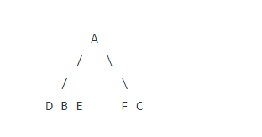
Pre order and In order
Inorder sequence: D B E A F C
Preorder sequence: A B D E C F

Slide 91
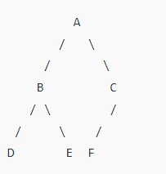
Pre order and In order
Inorder sequence: D B E A F C
Preorder sequence: A B D E C F

Slide 92
Pre order: 1, 2, 4, 3, 5, 7, 8,6
In order: 4, 2, 1, 7, 5, 8, 3, 6

Slide 93
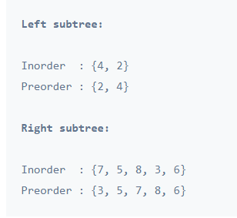
Pre order: 1, 2, 4, 3, 5, 7, 8,6
In order: 4, 2, 1, 7, 5, 8, 3, 6

Slide 94
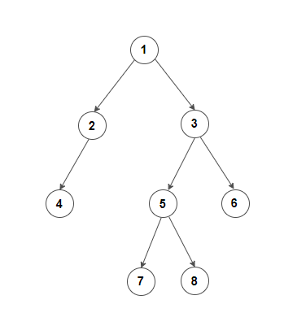
Pre order: 1, 2, 4, 3, 5, 7, 8,6
In order: 4, 2, 1, 7, 5, 8, 3, 6

Slide 95
Post order and In order
inOrder = { 4, 2, 5, 1, 6, 3, 7 };
postOrder = { 4, 5, 2, 6, 7, 3, 1 };.

Slide 96
Level order and In order
in[] = {4, 8, 10, 12, 14, 20, 22};
level[] = {20, 8, 22, 4, 12, 10, 14};

Slide 97
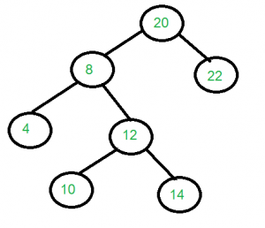
Level order and In order
in[] = {4, 8, 10, 12, 14, 20, 22};
level[] = {20, 8, 22, 4, 12, 10, 14};

Slide 98
Create Tree using Pre-Order and Post Order
It is not possible to construct a general Binary Tree from preorder and postorder traversals. But if know that the Binary Tree is Full, we can construct the tree without ambiguity.
This is so because we cannot separate the left sub-tree and right sub-tree using the pre-order or post-order traversal alone.

Slide 99
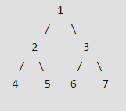
Create Tree using Pre-Order and Post Order
A Full Binary Tree is a binary tree where every node has either 0 or 2 children

Slide 100
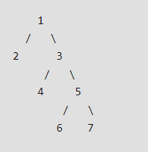
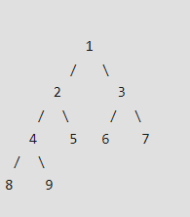
Create Tree using Pre-Order and Post Order
A Full Binary Tree is a binary tree where every node has either 0 or 2 children

Slide 101
Create Tree using Pre-Order and Post Order
pre[] = {1, 2, 4, 8, 9, 5, 3, 6, 7} and
post[] = {8, 9, 4, 5, 2, 6, 7, 3, 1};
In pre[], the leftmost element is root of tree.
Since the tree is full and array size is more than 1. The value next to 1 in pre[], must be left child of root.
So we know 1 is root and 2 is left child.
How to find the all nodes in left subtree?
We know 2 is root of all nodes in left subtree. All nodes before 2 in post[] must be in left subtree.
Now we know 1 is root, elements {8, 9, 4, 5, 2} are in left subtree, and the elements {6, 7, 3} are in right subtree.

Slide 102
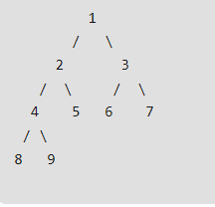
Create Tree using Pre-Order and Post Order

